Slide 1
 | Zane & Jawad | Sibi & Hudson | Gathik & Zac
Logan & Abbey | Jamie & Eftekhar | Imran & Sashant | Ishmeet & Louisa
Kaeden & Caelen | Liam & Ciani | Damien & Una | Tyson & Amberlie
Niwa & Carisa | Desmond & Alex | Jesse & Phoebe | Rhian & Isabella

Slide 2
Review of classroom rules
We enter the classroom
When we are note taking
When we are doing experiments
When we finish the class
WHAT SHOULD WE DO WHEN…

Slide 3
Review of classroom rules
WHAT SHOULD WE BRING TO CLASS?

Slide 4
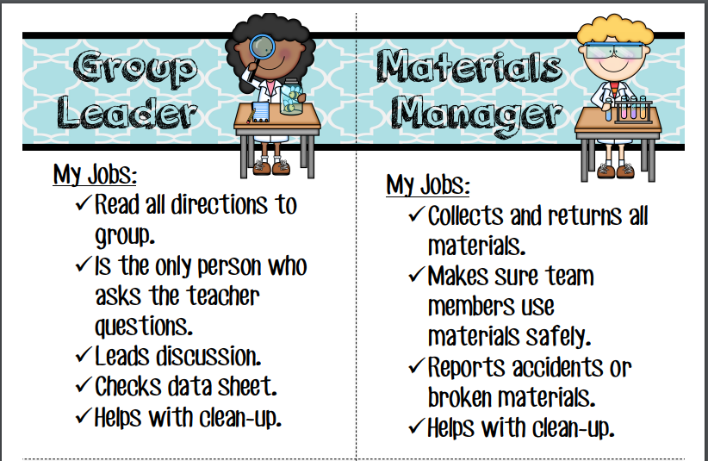
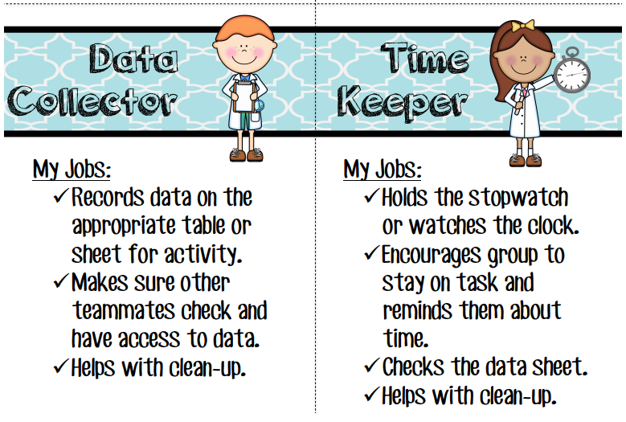
Review of classroom rules
Experiments and group work

Slide 5
Review of classroom rules
By the end of the lesson:
Decide on a group name and write it on the green piece of paper on your desk.

Slide 6
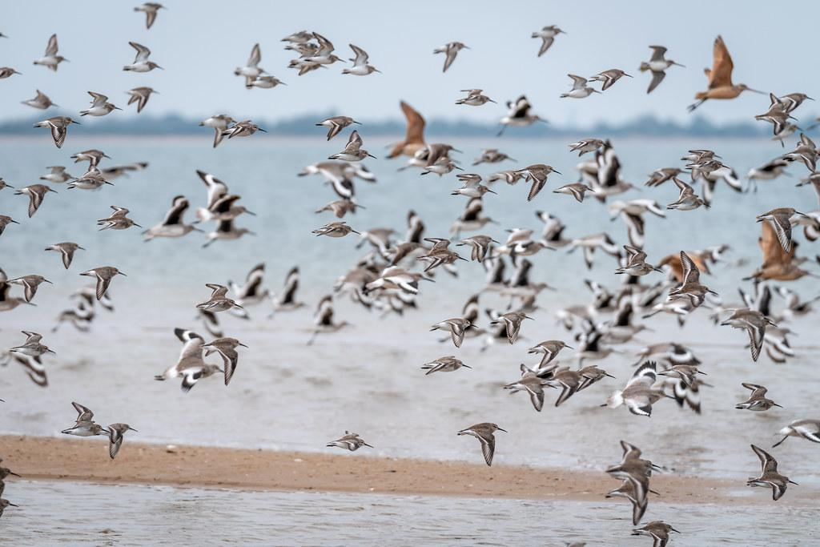
DICHOTOMOUS KEY
We will classify organisms using dichotomous keys.
Notes:
Insert cover image and use transparency settings to fade image.

Slide 7
Do not delete this slide.
This slide is designed so that you can copy the prompt box you need and insert it into your slides.
This slide is hidden and will not be included when presenting your lesson.
TRACK WITH ME
VOCABULARY
1 -
HINT
Students, remember….
CHECK FOR UNDERSTANDING
READ WITH ME
TEACHER CUE
MAKE THE CONNECTION
Students, you already know….
EXTENSION
GESTURE WITH ME

Slide 8

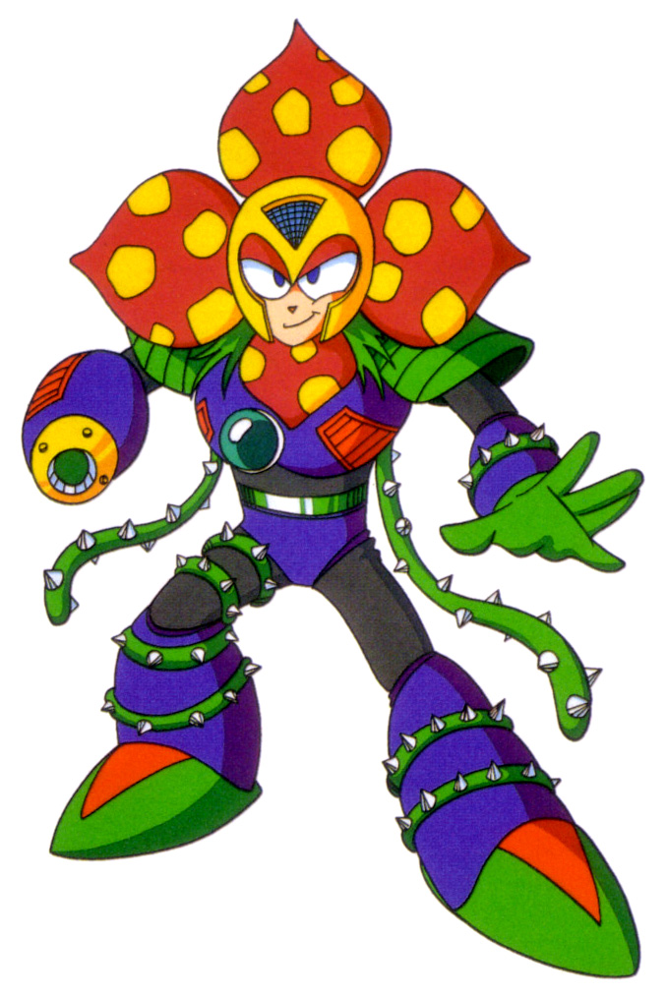
We will describe the characteristics of organisms.
The eight (8) characteristics of all living things are:
M
R
S
G
R
E
N
C

Slide 9
Repeat the opposite word/phrase.
ORGANISM
LIVING THING

Slide 10
Repeat the opposite word/phrase.
CONTACT FORCES
PHYSICAL CONTACT

Slide 11
Repeat the opposite word/phrase.
NON-CONTACT FORCES
NO PHYSICAL CONTACT

Slide 12
Repeat the opposite word/phrase.
WEIGHT
MEASUREMENT OF GRAVITY

Slide 13
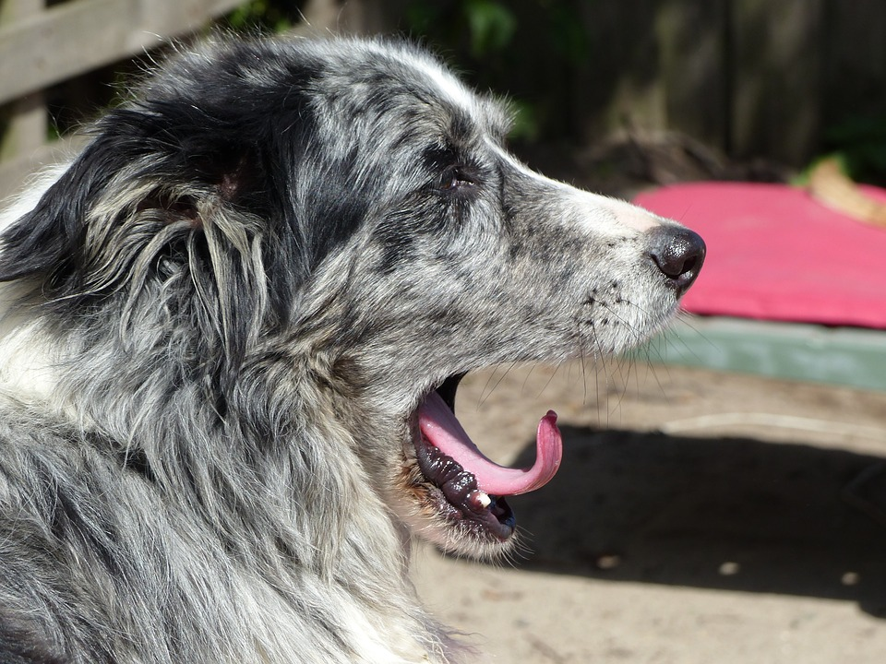
Using the picture, what are some observations?
Using the picture, what are some inferences?

Slide 14
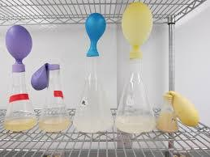
In this experiment, balloons were placed on top of flasks filled with different temperatures of water. The size of the balloons was measured after 10 minutes.
In your group discuss:
What the independent variable is?
What the dependent variable is?
What would be two controlled variables?

Slide 15
We will classify organisms using dichotomous keys.
TRACK WITH ME
READ WITH ME
We will define key.
We will define dichotomous.
We will use provided dichotomous keys to classify organisms.
We will construct dichotomous keys.
DECLARE THE OBJECTIVE
Read the learning objective to your partner.
Notes:
Learning Objectives contain concepts (nouns, big ideas), skills (verbs, measurable behaviours) and sometimes context (restricting or targeting conditions).
●Example: Students will be able to describe the concept of density and apply it to floating and sinking.
●
Success criteria are specific measurable outcomes that if met mean that the student has met the learning objective.
Examples:
•Students will be able to compare densities of substances using mass and volume.
•Students will be able to identify whether a solid or liquid will float or sink in a liquid based on their densities.

Slide 16
We will classify organisms using dichotomous keys.
When you visit a supermarket the aisles are classified into certain food groups making it easier to find the food you want.
Scientists use a system similar to this to sort things into groups, or classify them. The system makes the names and descriptions of organisms easier to find.
Can you think of another place where things are organised into groups?
MAKE THE CONNECTION
Students, you already know that we classify objects into similar groups.

Slide 17
We will classify organisms using dichotomous keys.
A key is a visual tool used in the classification₁ of organisms.
A key is often more useful than a list of characteristics₂ and similarities of each group.
A branched key (it looks like a tree) helps us see how a particular member of the group fits in with all the rest.
CHECK FOR UNDERSTANDING
Why would Scientists use a key when classifying organisms?
VOCABULARY
1- group of things with similar qualities. 2- a feature or quality

Slide 18
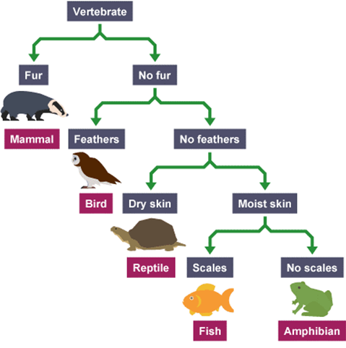
CHECK FOR UNDERSTANDING
How many sections is a branch split into for a dichotomous key?
We will classify organisms using dichotomous keys.
One common type of key is called the dichotomous key (pronounced ‘dye-COTo-muss’)
Di = ‘two’,the branches split into two.
Scientists use this type of key to make simple ‘yes’ or ‘no’ decisions at each branch. A branch may have a simple decision, like does the animal have fur?
Yes(left branch)/No(right branch)

Slide 19
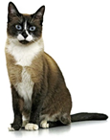
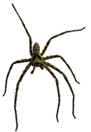
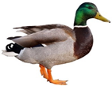
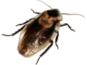
We will classify organisms using dichotomous keys.
Task: Create a dichotomous key to separate spiders, cockroaches, cats and ducks.
CHECK FOR UNDERSTANDING
First question to separate. Does the animal have feathers?
HINT
Students, remember…. Yes/no decisions separate an animal at each fork.

Slide 20
We will classify organisms using dichotomous keys.
CHECK FOR UNDERSTANDING
First question to separate. Does the animal have feathers?
HINT
Students, remember…. Yes/no decisions separate an animal at each fork.

Slide 21
We will classify organisms using dichotomous keys.
CHECK FOR UNDERSTANDING
Second question to separate. Is the animal covered in fur?
HINT
Students, remember…. Yes/no decisions separate an animal at each fork.

Slide 22
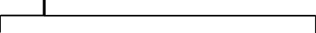
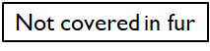
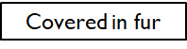
We will classify organisms using dichotomous keys.
CHECK FOR UNDERSTANDING
Second question to separate. Is the animal covered in fur?
HINT
Students, remember…. Yes/no decisions separate an animal at each fork.

Slide 23
We will classify organisms using dichotomous keys.
CHECK FOR UNDERSTANDING
Third question to separate. Does the animal have antennae?
HINT
Students, remember…. Yes/no decisions separate an animal at each fork.

Slide 24
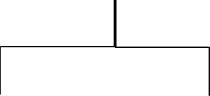
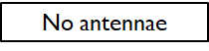
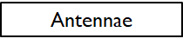
We will classify organisms using dichotomous keys.
CHECK FOR UNDERSTANDING
Third question to separate. Does the animal have antennae?
HINT
Students, remember…. Yes/no decisions separate an animal at each fork.

Slide 25
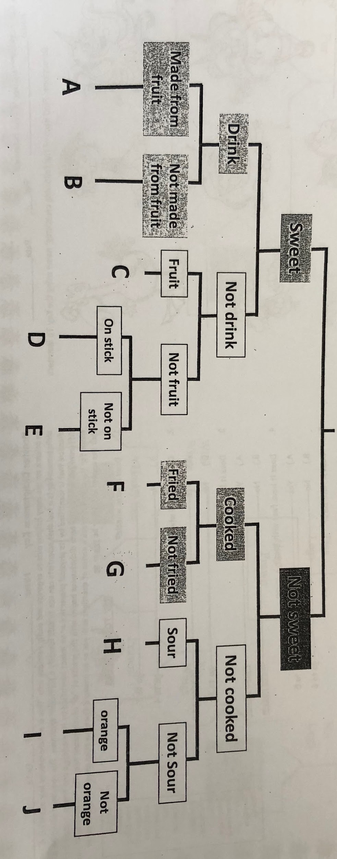
We will classify organisms using dichotomous keys.
HINT
Students, remember…. Branch can only be split in two and yes/no answers only.
Copy the dichotomous key below.
Which food belongs at each letter position shown at the bottom?
Write the food in the correct position on the key.
Food list:
Chips
Apple
Chocolate
Apple juice
Lollipop
Carrot
Lemon
Meat pie
Coca cola
Lettuce
Notes:
Please include tasks/questions here rather than just referring to a worksheet. This will save on photocopying and facilitate sharing with other schools.
Try and build tasks/questions which escalate through Bloom’s Taxonomy. This will help with differentiation.

Slide 26
We will classify organisms using dichotomous keys.
CHECK FOR UNDERSTANDING
Why is it called a dichotomous key?
Scientist use dichotomous keys to help classify organisms. The key makes the names and descriptions of organisms easier to find.

Slide 27
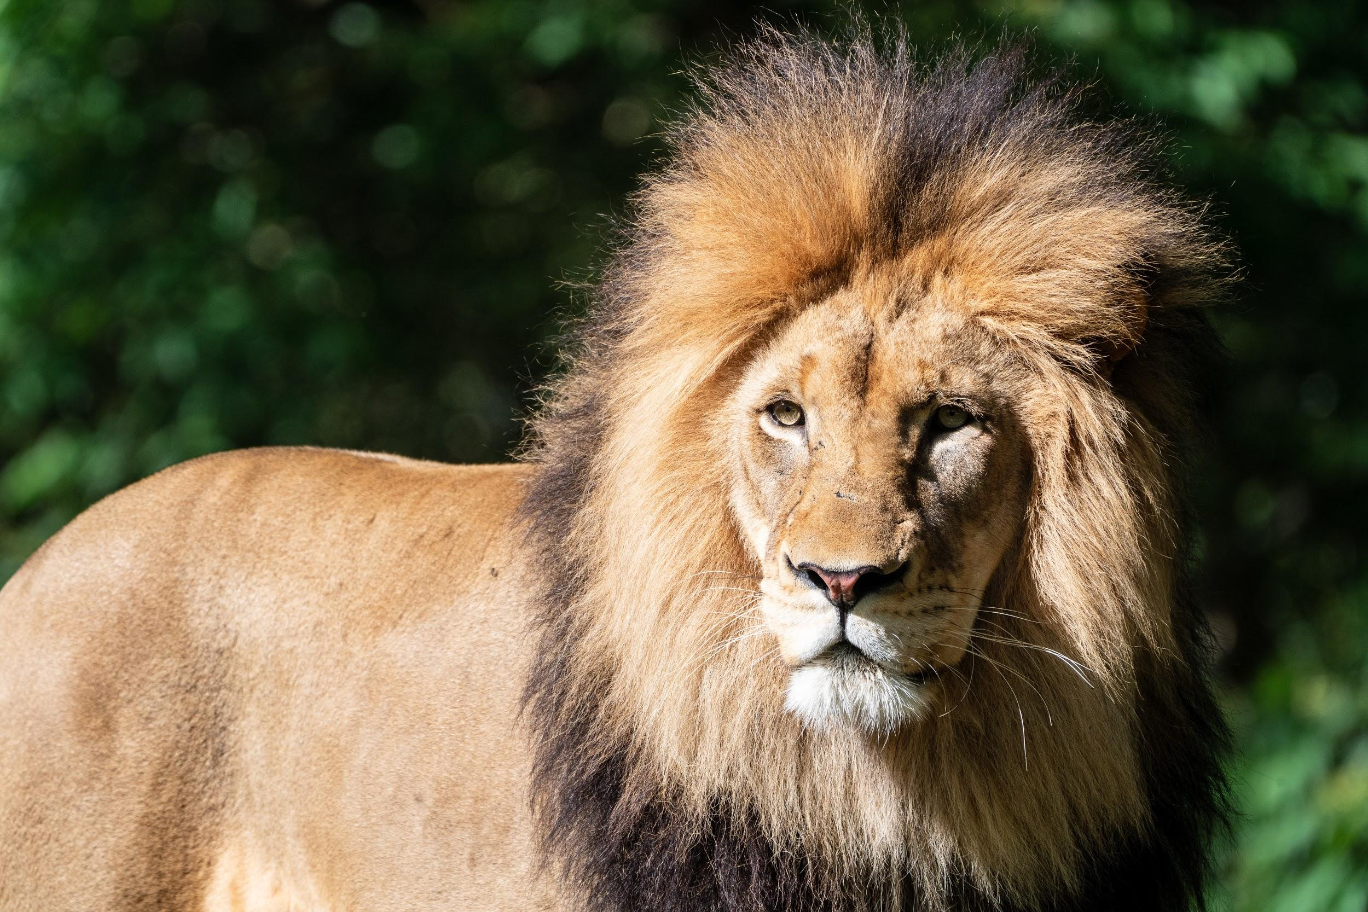
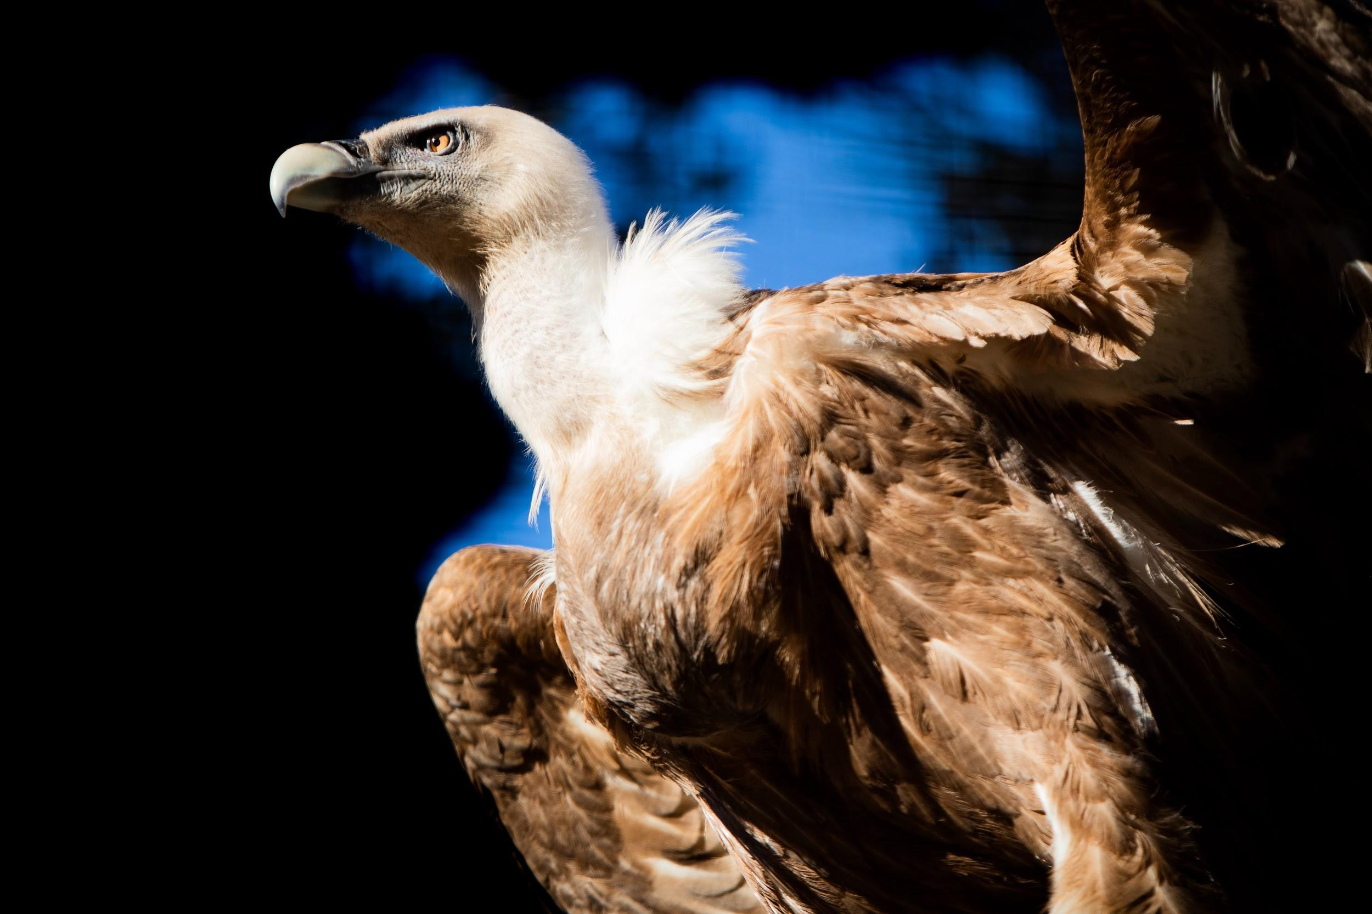
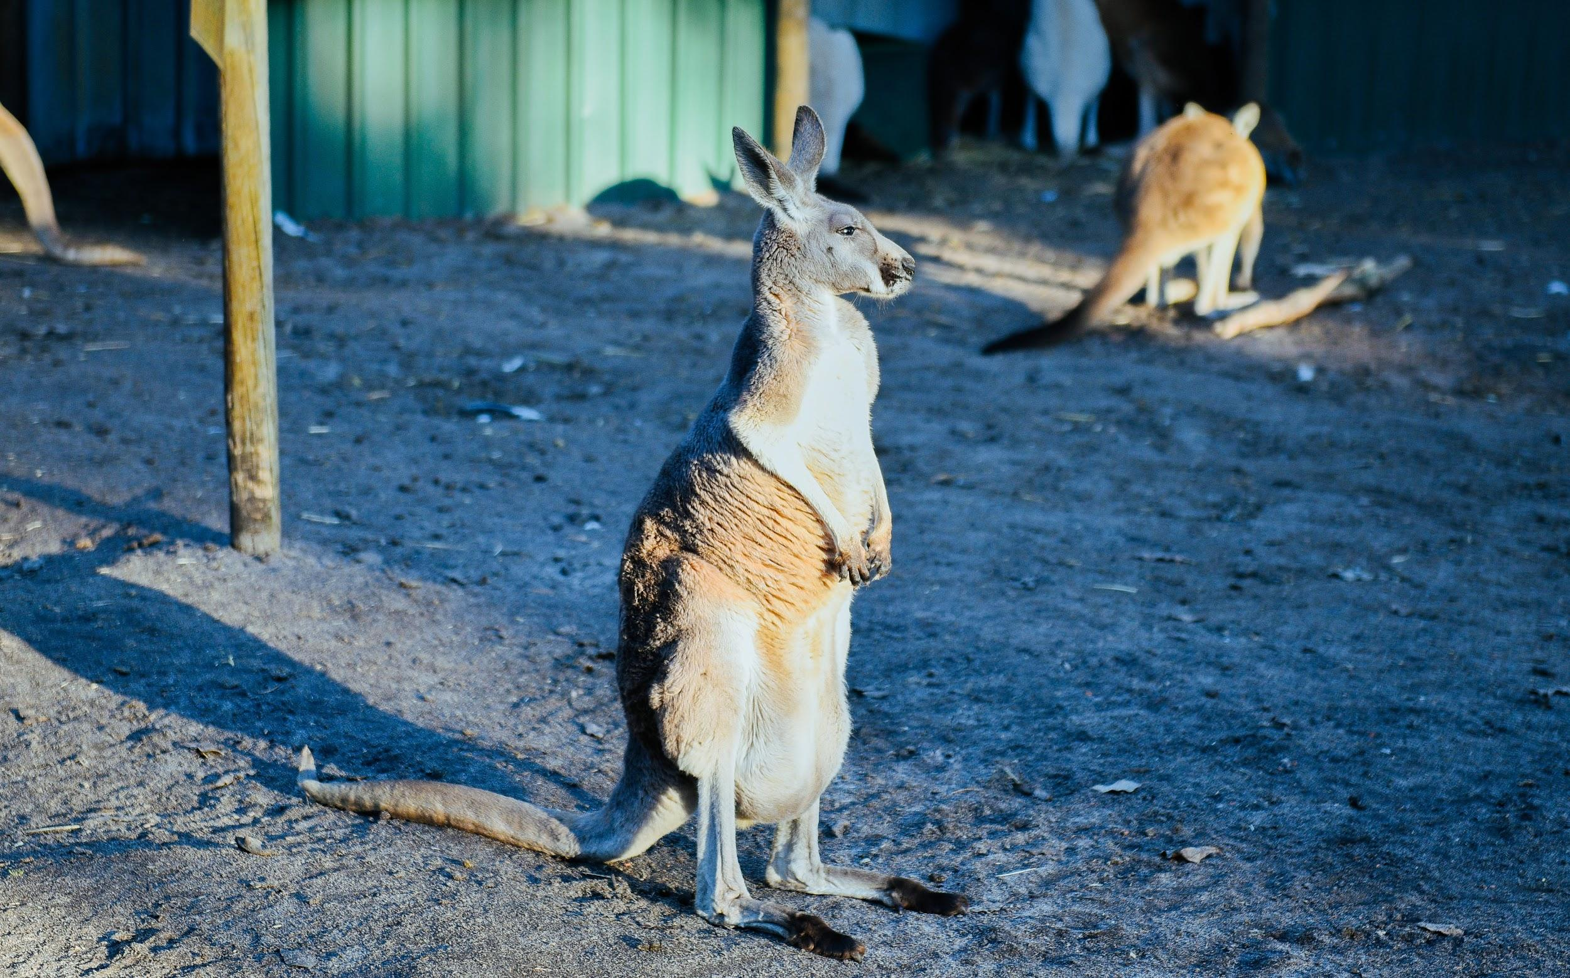
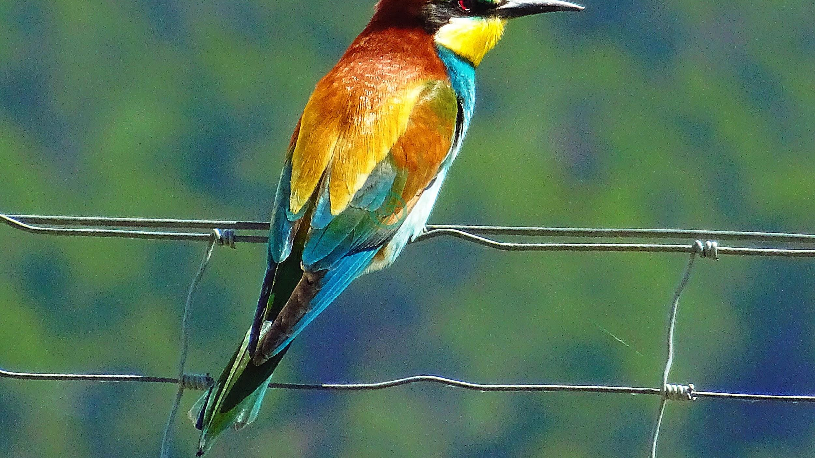
We will classify organisms using dichotomous keys.
Scientist use a dichotomous key to make simple yes/no decisions to help classify animals into groups.
Di = two, means that the branches will on split into two.
E.g. fur or no fur.
CHECK FOR UNDERSTANDING
Why do scientist use dichotomous keys?

Slide 28
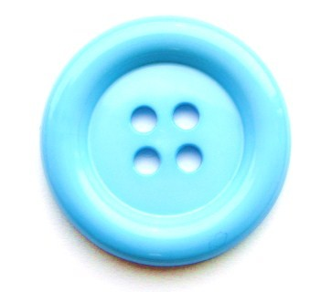
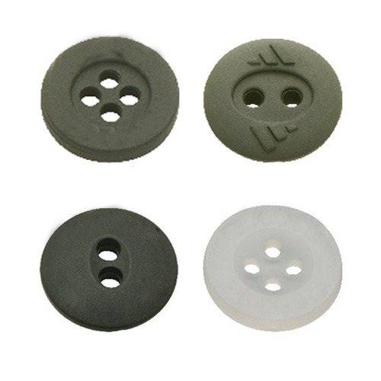
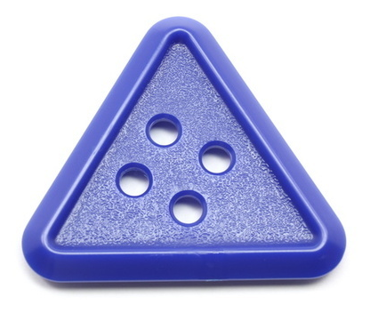
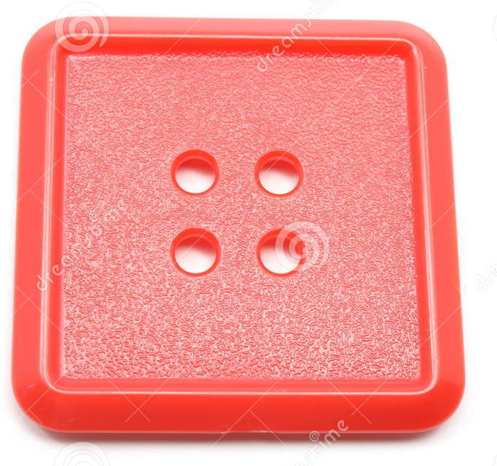
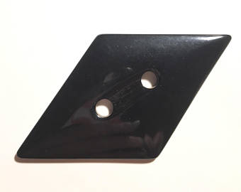
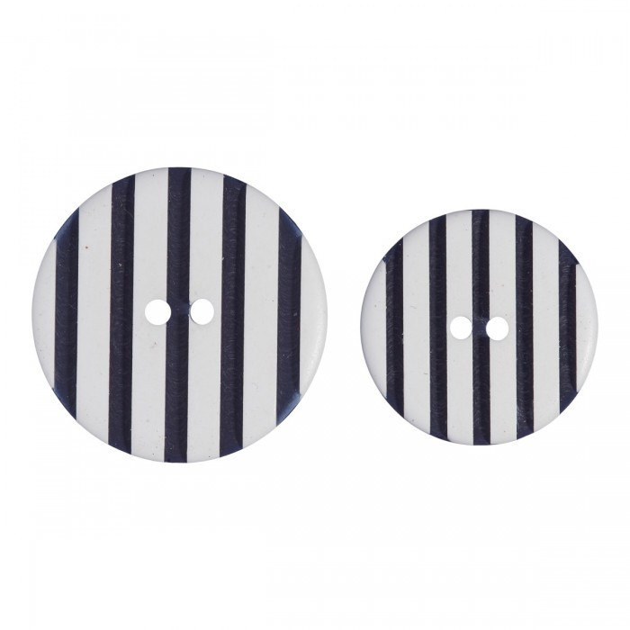
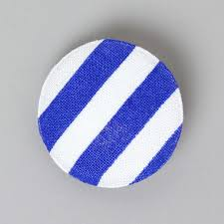
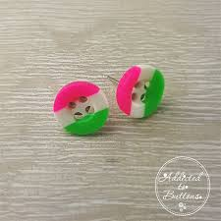
We will classify organisms using dichotomous keys.
Create a dichotomous key using the buttons below.
Start with buttons on top and first split is straight edge or no straight edge.
1
2
3
4
HINT
Students, remember…. Simple yes or no questions. Only two branches for each split.
6
7
8
5
Notes:
Please include tasks/questions here rather than just referring to a worksheet. This will save on photocopying and facilitate sharing with other schools.
Try and build tasks/questions which escalate through Bloom’s Taxonomy. This will help with differentiation.

Slide 29
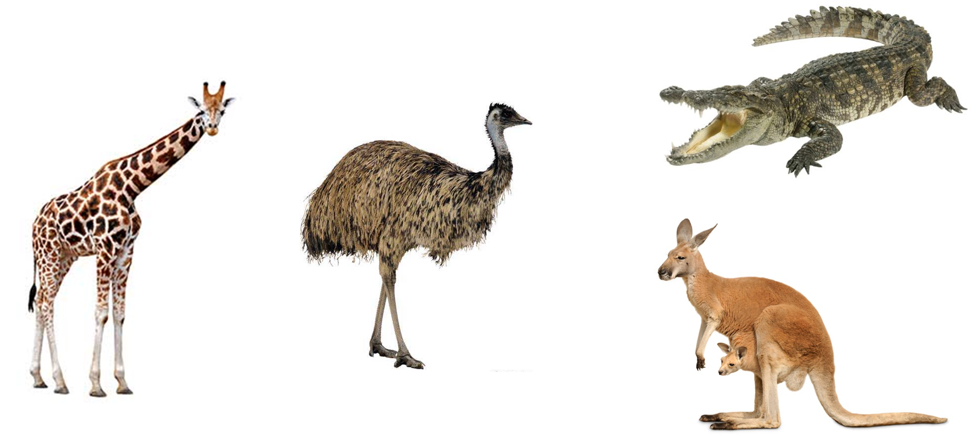
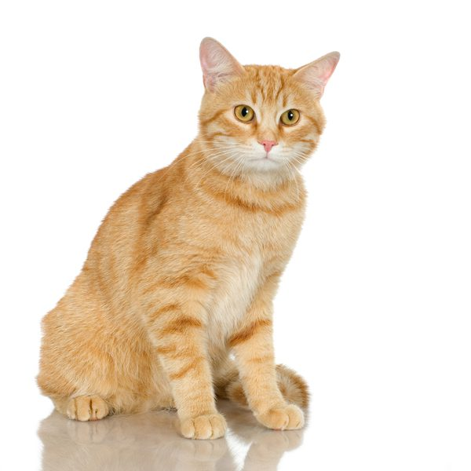
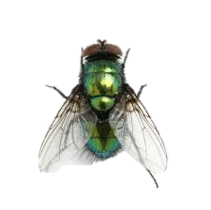
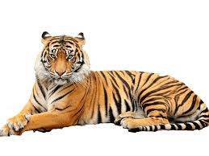
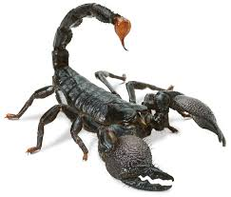
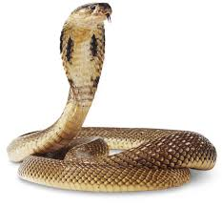
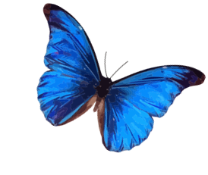
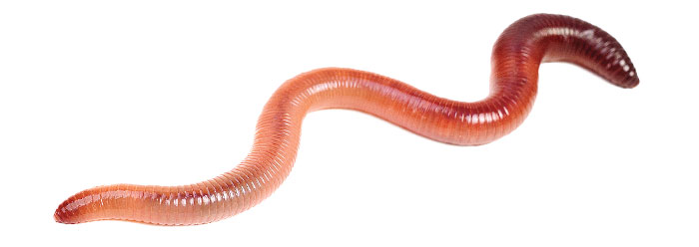
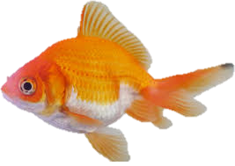
We will classify organisms using dichotomous keys.
Create a dichotomous key using the animals below.
HINT
Students, remember…. Simple yes or no questions. Only two branches for each split.
4
5
Crocodile
Cat
6
Fly
2
3
Emu
Kangaroo
1
Giraffe
9
7
Scorpion
Goldfish
12
11
10
Tiger
Cobra
Earthworm
8
Butterfly

Slide 30
We will classify organisms using dichotomous keys.
We will define key.
We will define dichotomous.
We will use provided dichotomous keys to classify organisms.
We will construct dichotomous keys.
CHECK FOR UNDERSTANDING
Check Success Criteria.

Slide 31
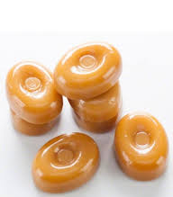
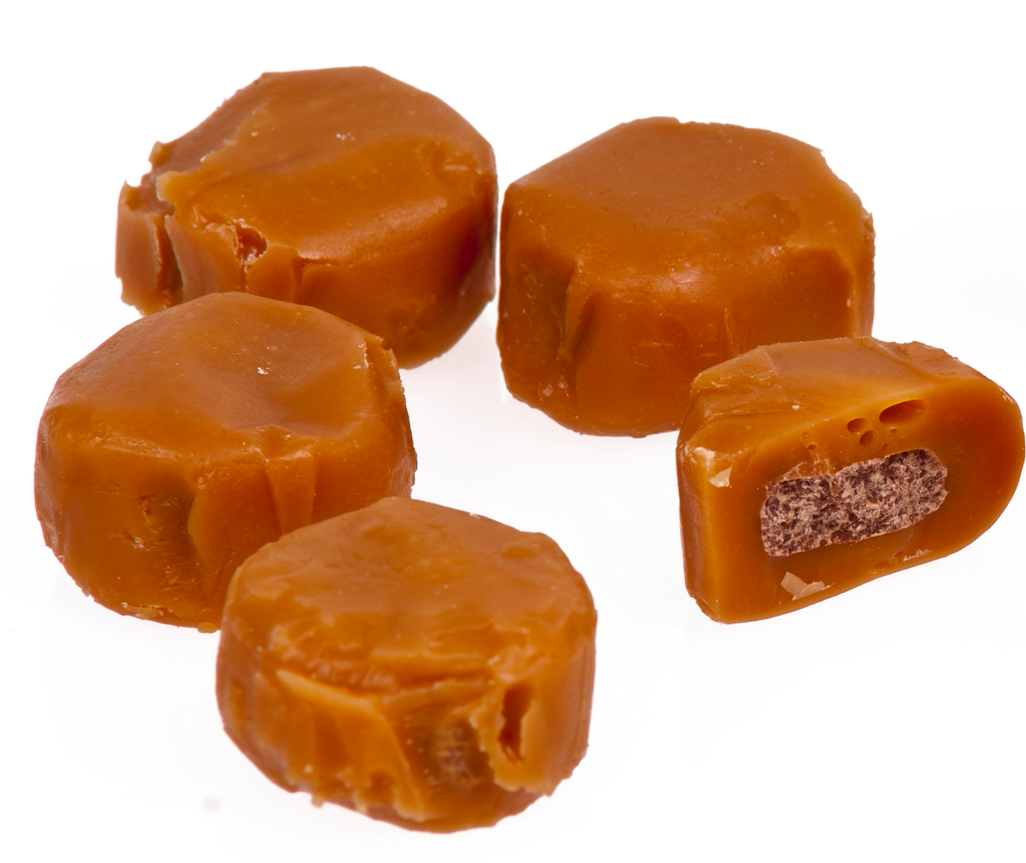
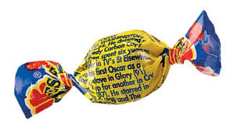
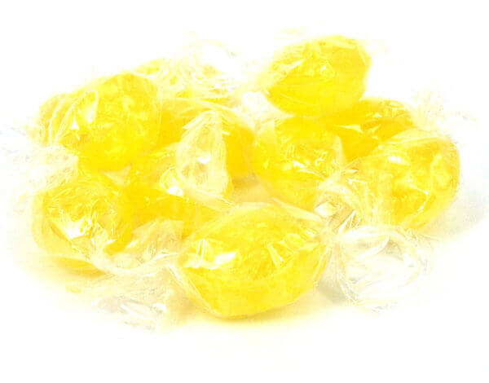
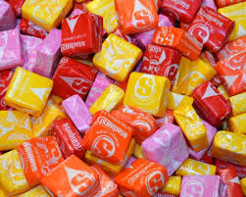
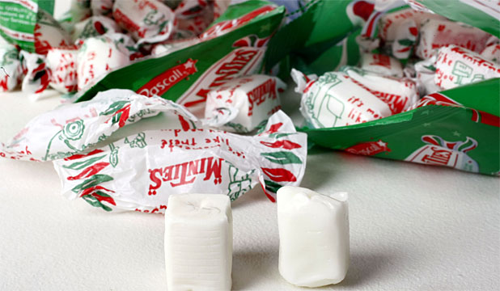
We will classify organisms using dichotomous keys.
Create a dichotomous key using the lollies below.
HINT
Simple yes or no questions. Only two branches for each split. Think: Shape Flavour Colour Wrapping
1
Butterscotch
2
3
Fantale
Chocolate Eclair
4
Lemon Sherbert
5
6
Mintie
Starburst chew

